Slide 1
Matrimonial WebAPP

Slide 2
Introduction:
The main objective of Matrimonial Web Application is to provide Grooms and Brides with excellent matchmaking experience by exploring the opportunities and resources to meet true potential partner.
User can get information regarding their dream life partner at his/her home at his/her convenience. This application also provides a search utility which helps those users who have a certain criteria of qualities in mind to make online matrimonial easier

Slide 3
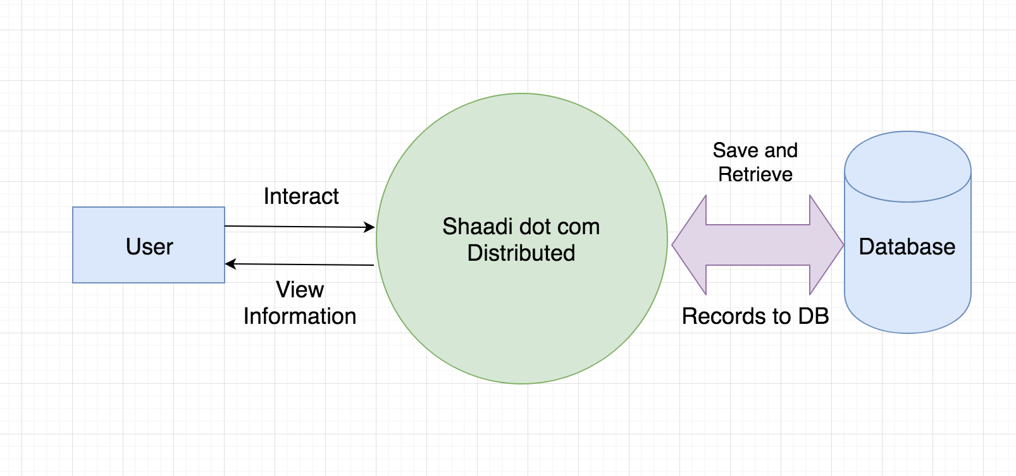
Diagram:

Slide 4
Scope & Objectives
Matrimonial website which will provide platform to a lot of Bride/Groom for finding perfect match.
There are different sectors like Registration, Partner Search, etc. So the Bride/Groom can get their interest for find their partner. Bride/Groom can directly search Partner according to their required criteria.
This application is specially designed for those who have problems in finding partner.

Slide 5
Features:
User can get information regarding their dream life partner at his/her home at his/her convenience.
The Bride/Groom can use match By Email functionality so he/she can get directly E-mail alert for the match which fulfill their required criteria.
This Application will be available for all devices who have internet/ Data package.

Slide 6
Tools & Technologies:
Visual Studio Code 1.19.1
Html5/Css3
ReactJs/ Redux
NodeJs/ Expressjs
Mongodb(for Database)
Adobe Photoshop

Slide 7
Thanks You

Slide 8
Problem & Solution:
The problem & solution of the entitled project is for every user to use in their daily life for random to find the perfect life partner.
Matrimonial Web Application will allow a new user to register and after successfully registration user can get email confirmation and his/her profile will be visible to other users.
If any individual who want to use this App simply Enter the name on Google (shaadidotcom), simply open it and Good to go, After the search he can find the perfect match us.

